Slide 1

Playwright Test Generator (Codegen)
Automatically generate test code based on your browser interactions. Think of it as a test recorder that watches and writes code for you.

Slide 2
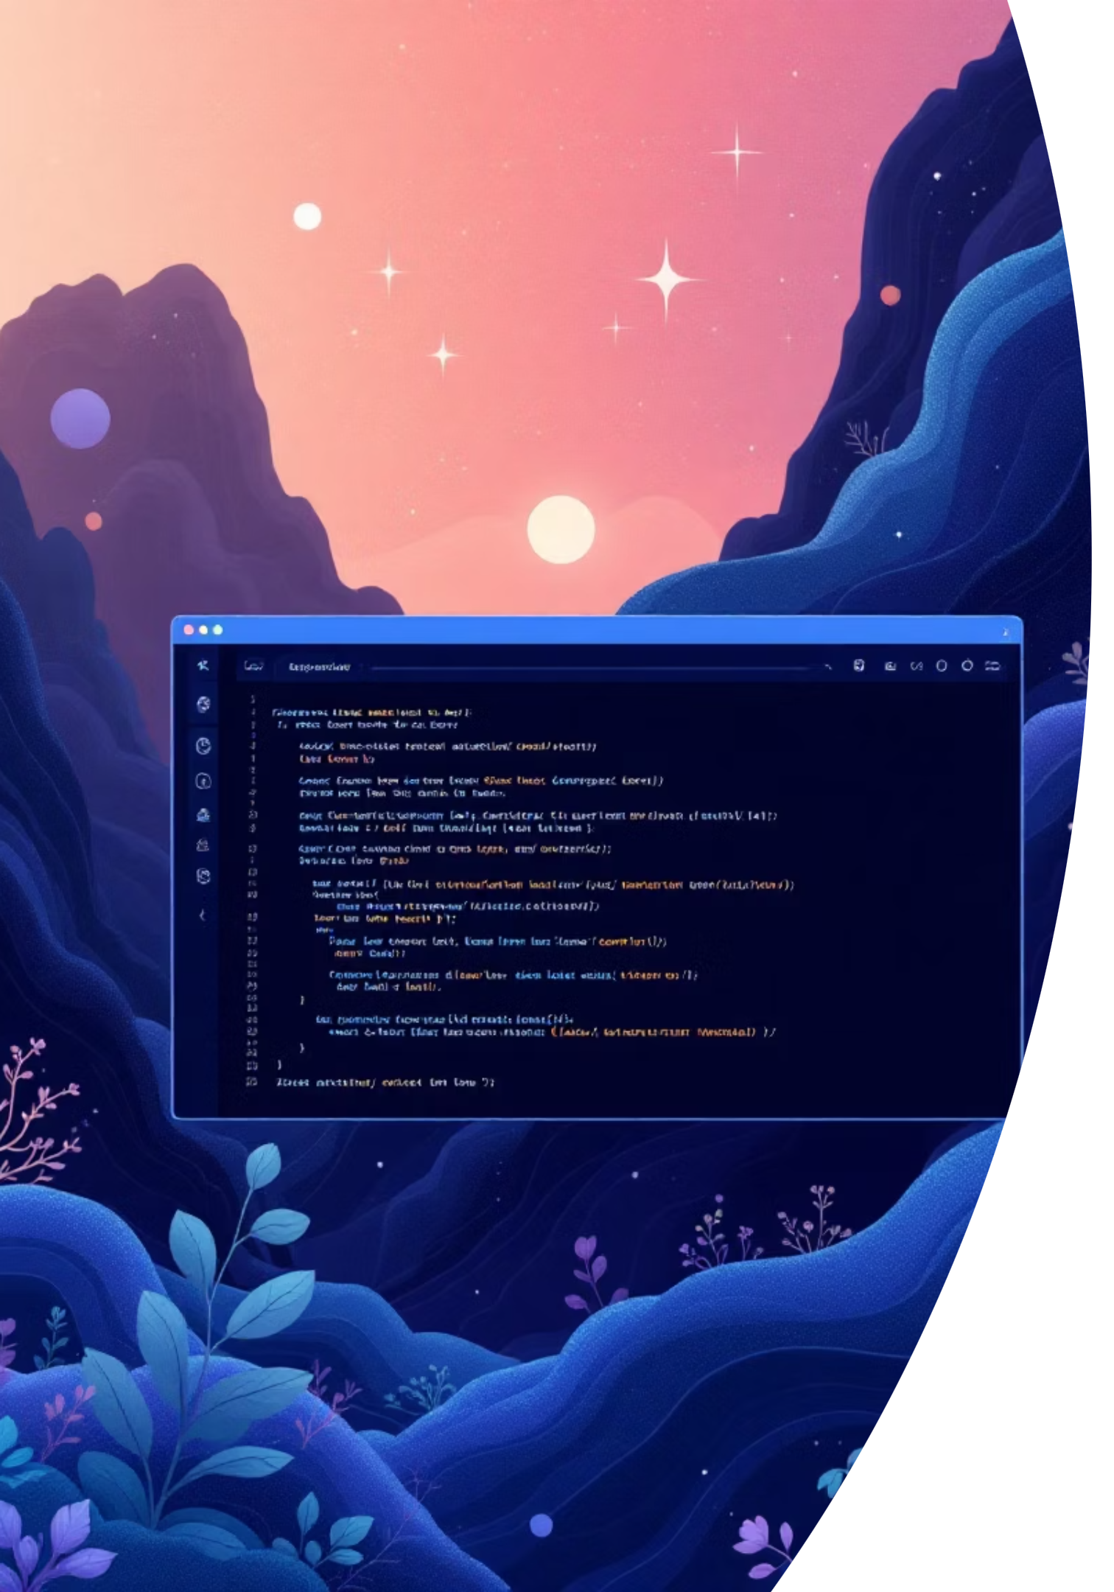
What is Codegen?
01
02
Open Browser
Interact Naturally
Launch browser using Codegen command
Click buttons, type in fields, navigate pages
03
Code Generated
Playwright watches and writes test code automatically

Slide 3






Why Use Codegen?
Saves Time
Learn Faster
Quick UI Testing
No need to write test code manually - generate scripts instantly
Perfect for beginners to understand Playwright test structure
Rapidly create test scripts for complex user flows

Slide 4
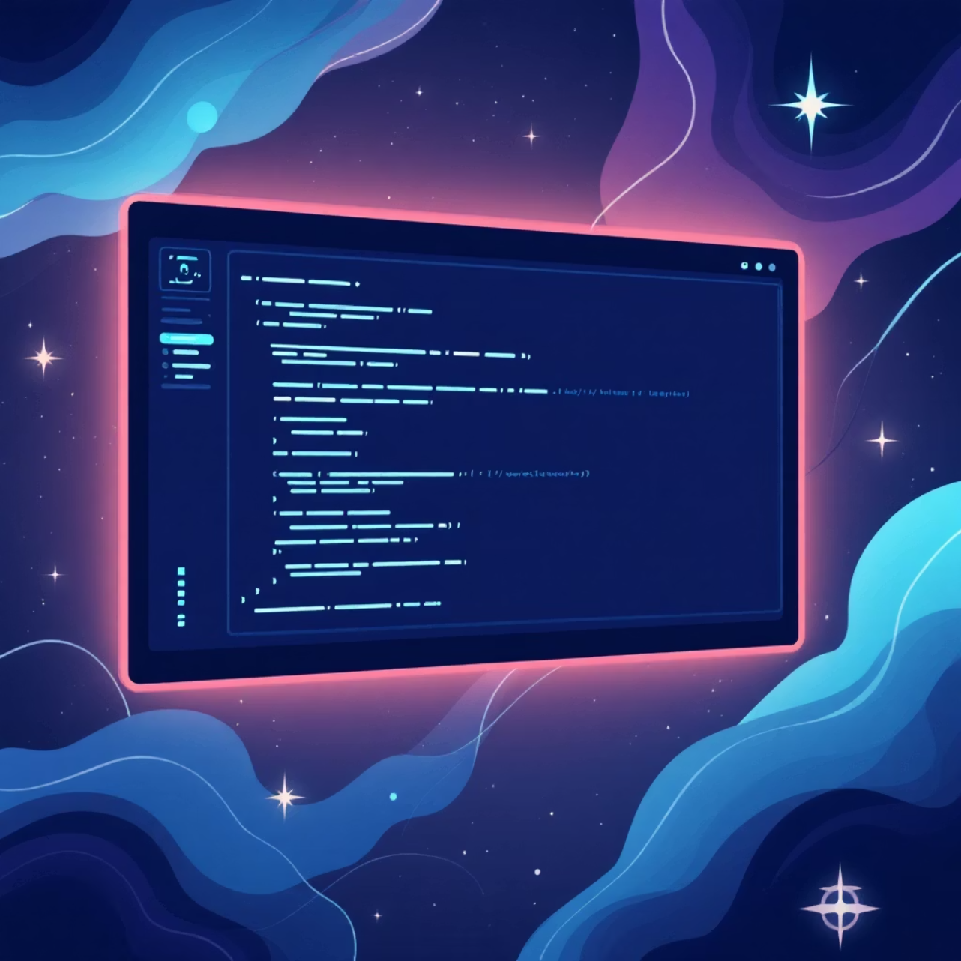
Getting Started
Basic Command
npx playwright codegen https://example.com
This launches a browser window and Playwright Inspector side by side, recording your actions and showing generated code live.

Slide 5
Essential Codegen Commands
1
2
Save to File
Choose Browser
npx playwright codegen -o tests/mytest.spec.ts
npx playwright codegen --browser=chromium
3
4
Device Emulation
Custom Viewport
npx playwright codegen --device "iPhone 15"
npx playwright codegen --viewport-size "1280,720"

Slide 6
Command Reference
Purpose
Command Example
Open browser & inspector
npx playwright codegen
Open with URL
npx playwright codegen https://example.com
Save to file
--output tests/test.spec.ts
Choose browser
--browser=chromium
Emulate device
--device "iPhone 15"

Slide 7



Debugging with Playwright Inspector
Debug Mode
Interactive Locators
Strategic Pauses
Run tests step by step with visual feedback
Pick and test selectors in real-time
Use page.pause() for precise breakpoints
npx playwright test tests/mytest.spec.ts --debug

Slide 8


Master Your Testing Workflow
Debug Command
npx playwright test --debug
Add Breakpoints
await page.pause();
Place strategic pauses in your test code to inspect specific steps and interact with the browser in debug mode.
Pro Tip: Combine codegen for rapid test creation and inspector for precise debugging - your complete Playwright testing toolkit!

